Slide 1
Study material site

Slide 2


Slide 3
ACKNOWLEDGEMENT
It gives us great pleasure to present the synopsis of the B.Tech mini project (Study Material) undertaken during B. Tech III Year. This project is going to be an acknowledgment of the inspiration, drive, and technicalassistance that will be contributed to it by many individuals. We owe a special debt of gratitude to Mr. Akash Kumar Chaudhary (Technical Trainer Department of CEA), for providing us with an encouraging platform to develop this project, which thus helped in shaping my abilities towards a constructive goal, through his constant support and guidance to our work. We also do not like to miss the opportunity to acknowledge the contribution of all department faculty members for their kind guidance and cooperation. By: Manali Sahu (201500380) Ayush Tiwari(201500184) Aryan Gupta (201500150) Divyansh Bhargava(201500231)

Slide 4
ABSTRACT
The project aims to put forward a solution for the students to learn and practice the courses from anywhere. It is an E-Learning platform. The idea of the project is that the student has to login with the credentials that he/she can able opt for any subject to read or he/she can able to watch videos related to that topic. There is also the admin portal where the admin can add more courses, update the courses, videos, and many more. After learning students can assist with the test by giving a small quiz on the selected topic of his/her own. The algorithm is designed to provide the resources in a more easy way so that a student doesn’t have to search for any topics or courses. Through this students can save time and study more efficiently. The technologies we have used are HTML, CSS, and javascript with the backend using Php with Xampp server.

Slide 5
INTRODUCTION
In this, we will build one interesting application that will related with the study materials provided to the students . To build this application we will use JavaScript ,Html ,CSS. This is one of the exciting and thrilling applications. While building this application we have used various libraries. First of all Student have to register into the application through Register Portal and then he/she can able to access all the features.
In our Project there are all the contents of subjects which a BTech Student have to study .All the pdf ,All books reference ,Important websites Video Lectures are there. It also content Admin portal where Admin can upload the data related to any subjects . There is a schedule section for the student also .

Slide 6
Process used by our site
Step 1: Welcome to the Study Material Application
Step 2: Free Trail Page For the Student Step
3: Student Portal For the Registration
Step 4: Choose your year of studying i.e. 1st yr,2nd yr. so on
Step 5: Select the Subject and the contents Choose the video lectures, notes, pdf, and website related to the subject Choose the reference books and get the link if students have to buy Print the notes and the admin can upload the new Contents
Step 6: Preparing your own Schedule from the Scheduler
Step 7: Feedback form filled out by the student
Step 8: Social media connections of our application (e.g. Instagram ,twitter)

Slide 7
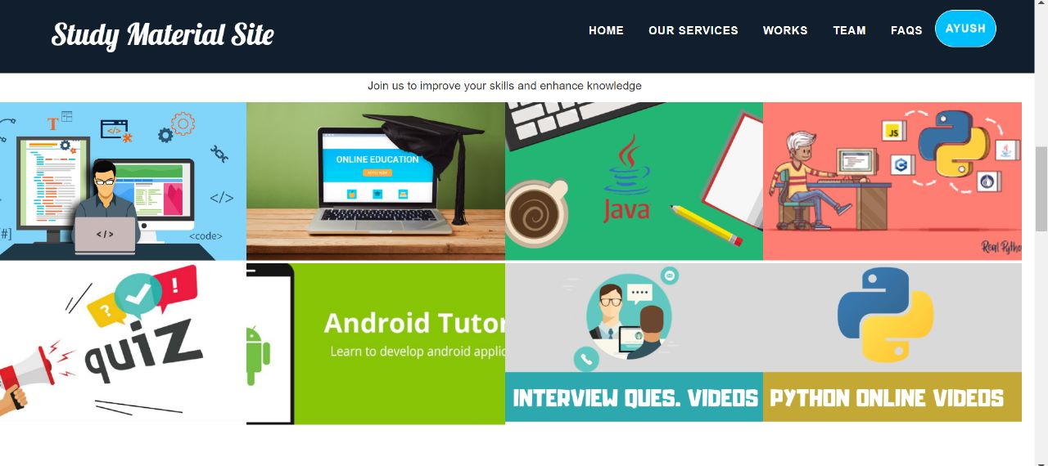

Slide 8
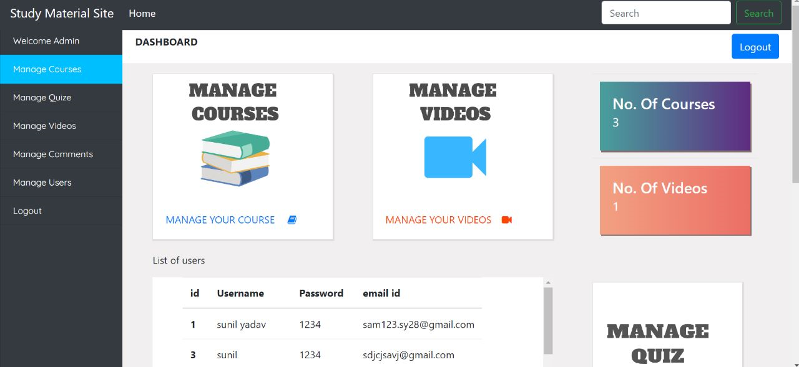

Slide 9
MOTIVATION
The idea behind choosing this project was to help the students in their studies. They don’t have to search for the syllabus and the content, all the contents are provided to them. Then even can print important material from this application. All the important books related to the subject are also on their buying website is also providing to them. All the project is related to student favor so that they can easily focus on their study rather than wasting time in searching for the content. We are trying our best to provide good facility to the student .

Slide 10
FUTURE SCOPE
There is a future scope of this facility that many more features such as online lectures and video tutorials can be added as well as online pdf, Previous Year Question papers are uploaded to the submission facility, Scheduler helps them to schedule their study routine a feature of feedback and online group discussions among students where they can discuss various issues of engineering subjects can be added to this project thus making it more interactive more user friendly and project which fulfills each users need in the best way possible.

Slide 11


